Slide 1

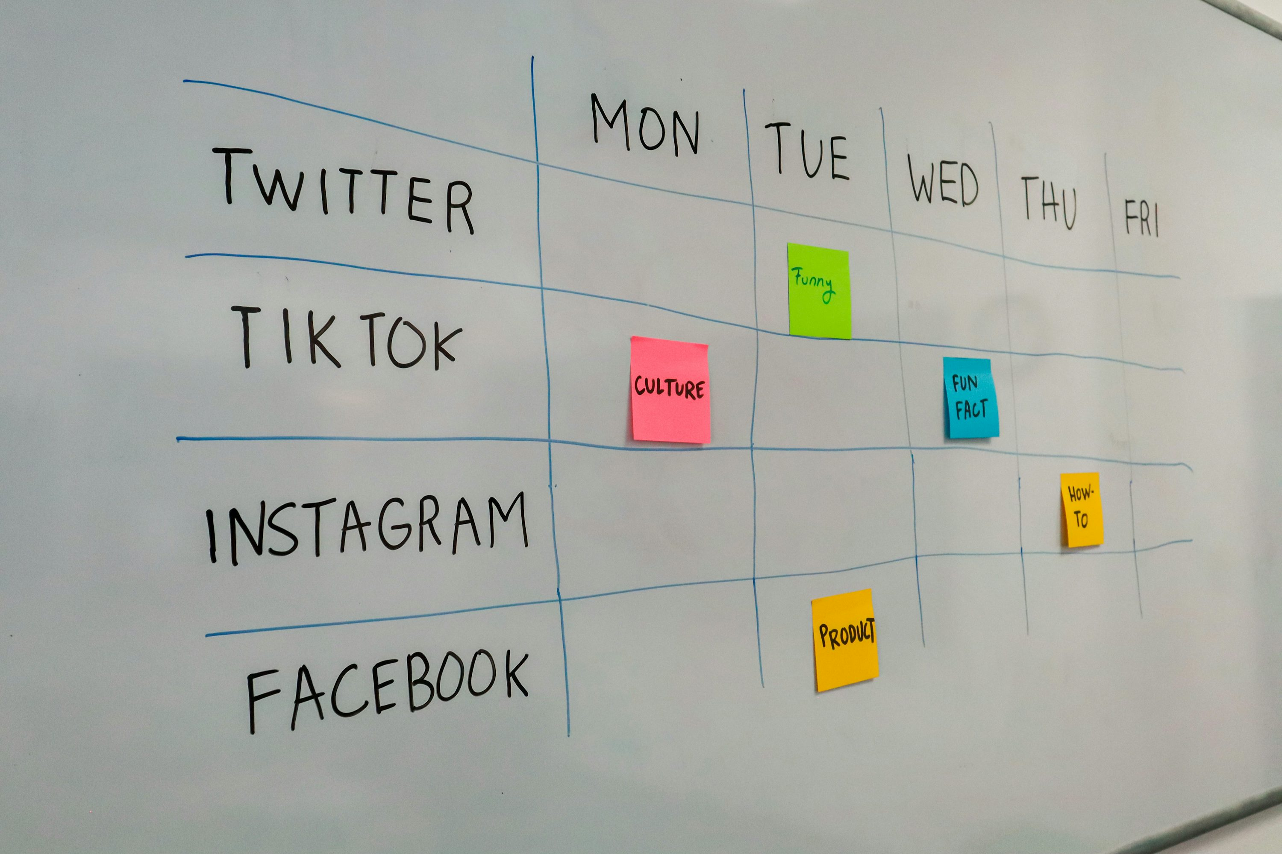
Social Media Project: An Analytical Approach to Engagement
Data-Driven Insights for Optimizing Social Media Engagement
Project: Social Media Project
Presented by: Abhishek Verma
Date: 07/10/2025

Slide 2

Project Introduction
Social Media Project: An Analytical Approach to Engagement
• Social media runs on engagement — posts, likes, comments, follows.
• Data reveals who stays loyal, who fades, and what trends rise.
• This project uncovers patterns that drive growth and influence.

Slide 3

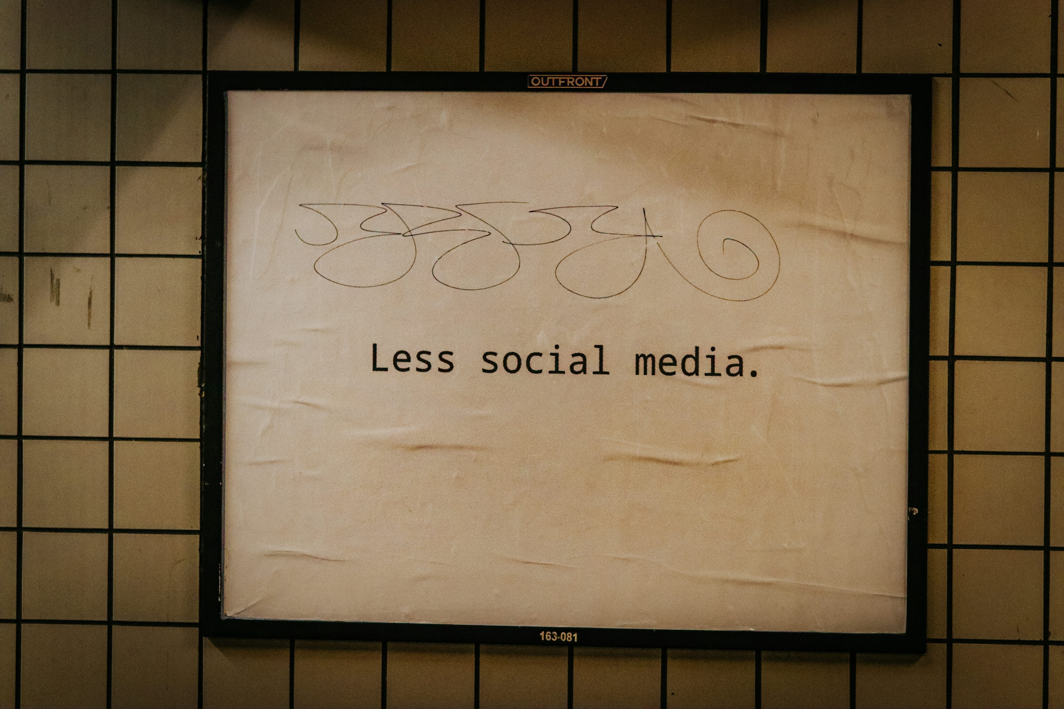
Problem Statement
• Social platforms face the challenge of keeping users active and engaged.
• Hard to spot the most loyal creators vs. silent spectators.
• Without insights, brands struggle to target, retain, and grow communities.

Slide 4
Data Overview
• Dataset mirrors an Instagram-like platform.
• Key tables: users, photos, comments, likes, follows, tags.
• Captures user activity, engagement, and content patterns.
• Primary fields include: user_id, photo_id, comment_id, tag_id, follower_id, followee_id, created_at, username, image_url.
DATA INTEGRITY: Clean foundation. Diagnostic checks confirmed no NULLs or duplicate records in key columns. The data is ready for high-level analysis.
DataSet Link: https://drive.google.com/file/d/1wSXXQboFYXgJXxccj4i-cKfIX5QtdPwH/view

Slide 5
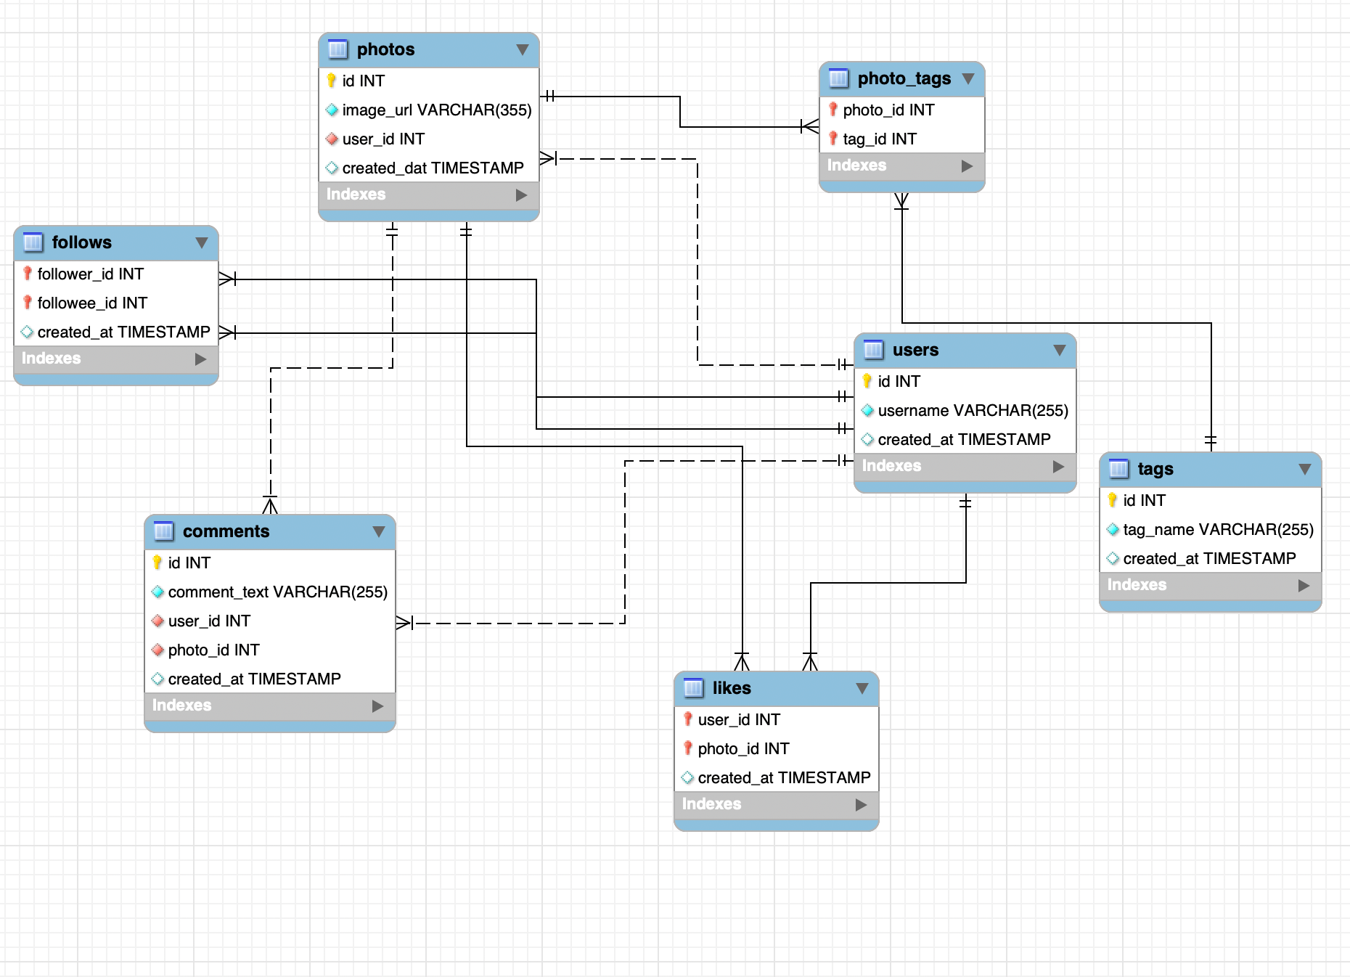
DataBase Schema

Slide 6
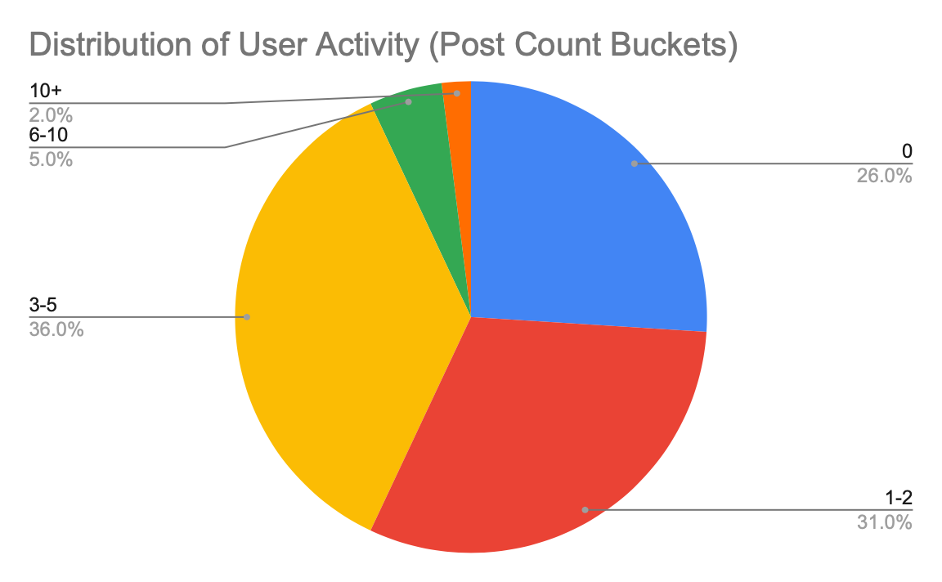
Distribution of User Activity
A quarter of the user base is completely inactive (Lurkers): 26.0% of all users have made zero posts.
The majority are low-volume creators: 57.0% of the user base has posted either 0 or 1−2 times, indicating high retention friction.
The core active segment posts moderately: The single largest group is the 3−5 post bucket, accounting for 36.0% of all users.
High-volume creators are rare: Only 7.0% of users fall into the high-activity tiers (6+ posts).
Recommendation: Focus retention efforts on moving the large 1−2 post segment into the 3−5 post segment to solidify activity.

Slide 7
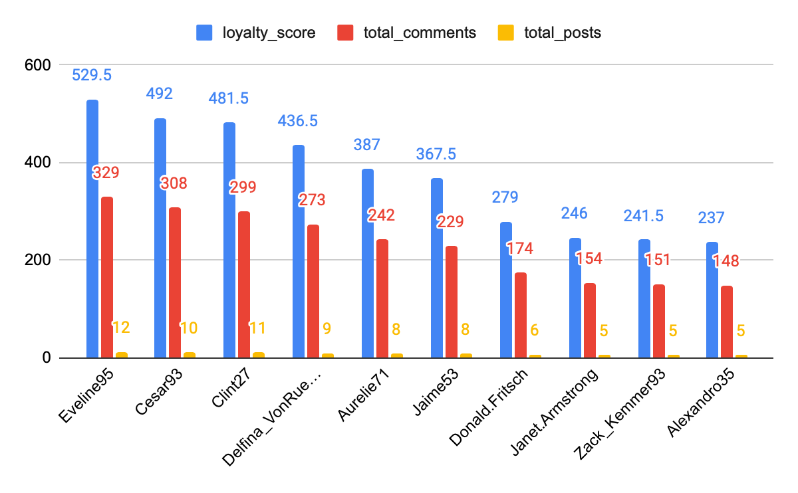
THE ENGINE ROOM: LOYALTY AND VALUE
Eveline95 is the benchmark: Leads with a Loyalty Score of 529.5, driven primarily by the highest total_comments (329) and total_posts (12).
Conversation is key: For all top users, Total Comments (red bars) is the single largest factor driving the overall Loyalty Score (blue bars).
Efficiency matters: Donald.Fritsch ranks high (score 279) despite having only 6 total posts, showcasing significant engagement efficiency over volume.
Cesar93 leads the pack: With a score of 492, he closely follows Eveline95, confirming him as a core asset for sustained activity.
Recommendation: INSTITUTE A REWARD MECHANISM: Grant these top-tier users "Top Contributor" status and exclusive feature access immediately.

Slide 8
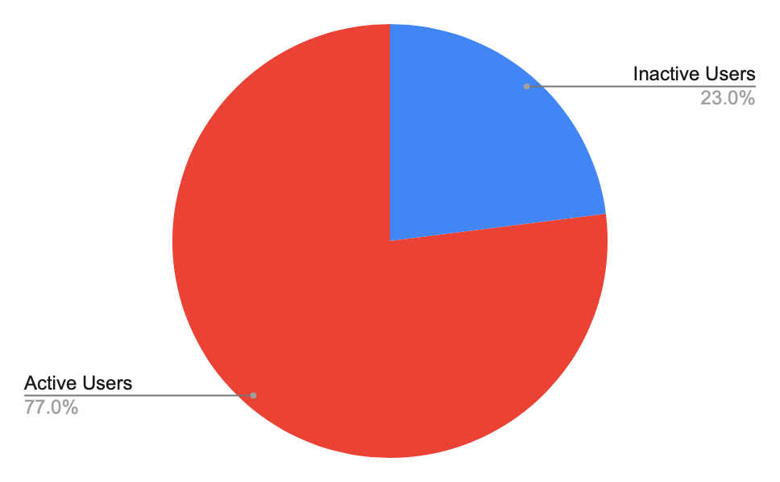
THE LURKER PROBLEM: INACTIVITY & ANOMALY
13 USERS ARE COMPLETELY INACTIVE: This segment (0 Posts, 0 Likes, 0 Comments) is a direct failure in our onboarding funnel and a pool of lost revenue potential.
THE "NEVER-LIKER" ANOMALY: Influential, content-heavy users (Eveline95, Cesar93) never like other posts. Their behavior is purely one-way, requiring a specialized engagement model.
SEGMENTATION IS CRITICAL: The user base splits clearly into Creators, Consumers (high interaction, no posts), and Inactive Lurkers. Generic strategy fails all three.
RECOMMENDATION: LAUNCH RE-ENGAGEMENT FUNNELS: Target Lurkers with personalized content nudges to achieve their first Like, then their first Post.

Slide 9
TIMING IS POWER: THE MANDATORY POSTING WINDOW
THE GOLDEN HOUR IS 6 PM (18:00). All measurable engagement is overwhelmingly concentrated at this single, non-negotiable time slot.
CONVERSATION SURGE. The 6 PM window produces 7,488 comment events, indicating strong conversational activity that must be capitalized on.
DEAD ZONES MUST BE AVOIDED. Any content deployed between 3 AM – 6 AM is wasted effort and dilutes content impact.
RECOMMENDATION: ENFORCE SCHEDULING MANDATE: Lock all high-value organic content and ad campaigns to the 6 PM slot.

Slide 10
CONTENT GOLDMINE: WHAT DRIVES LIKES
MOOD AND VISUALS PAY: The highest average likes per post are clustered around emotional and aesthetic themes: dreamy (≈35.75 avg likes), beauty, and stunning.
STABILITY: The differences between the top 10 tags are minimal, showing a stable zone of high-performing, reliable aesthetic themes.
EASY ENTRY: Posts average 1.95 tags, confirming users are consistent in their categorization, making tag-based targeting highly reliable.
RECOMMENDATION: PRIORITIZE AESTHETIC CONTENT: Funnel production resources toward lifestyle, mood, and food themes that leverage these top tags.

Slide 11
ACTIONABLE THEMES: THE STRATEGIC TAGS
'Beach' drives extreme conversation: The tag 'beach' generates an exceptionally high volume of engagement (1216 Avg comments per post), making it the single most conversational topic.
Experiential themes win: Lifestyle categories like 'concert' (676 comments) and 'party' (383.67 comments) are highly effective at driving mass discussion volume.
Aesthetic content is reliable: Tags like 'dreamy' (275.5 comments) and 'stunning' (117.25 comments) consistently deliver reliable, high-tier conversation.
Recommendation: INSTITUTE A TAG MANDATE: All branding and ad creatives must align with these top-performing lifestyle themes for immediate audience resonance.

Slide 12
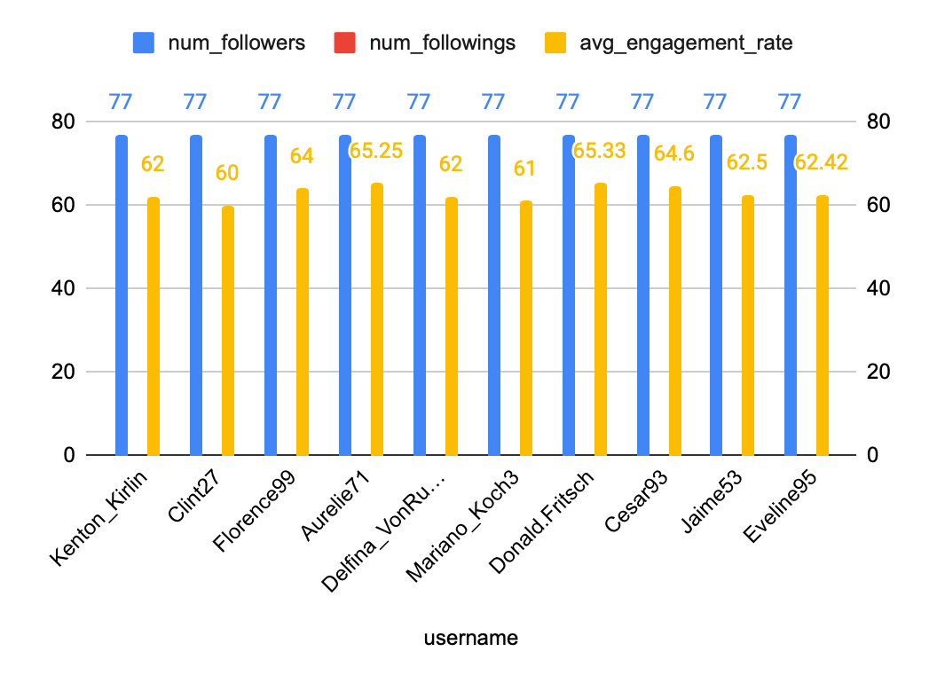
INFLUENCER PIPELINE: REACH VS. EFFICIENCY
Reach is Saturated: All top-tier users are tied at the maximum follower count (num_followers is 77), rendering the follower count useless for differentiation.
Engagement is the Differentiator: The avg_engagement_rate (yellow bars) is the single most critical metric for identifying high-value assets among max-reach users.
High-Efficiency Assets: Users like Donald.Fritsch (65.33%) and Aurelie71 (65.25%) are the top performers, demonstrating superior content efficacy.
Low-Efficiency Warning: Users like Clint27 and Mariano_Koch3 have the lowest engagement rates (60.0%), indicating their content has the lowest comparative ROI.
Recommendation: STRATEGY: Use high-reach users for Awareness campaigns and high-efficiency users for Conversion campaigns.

Slide 13
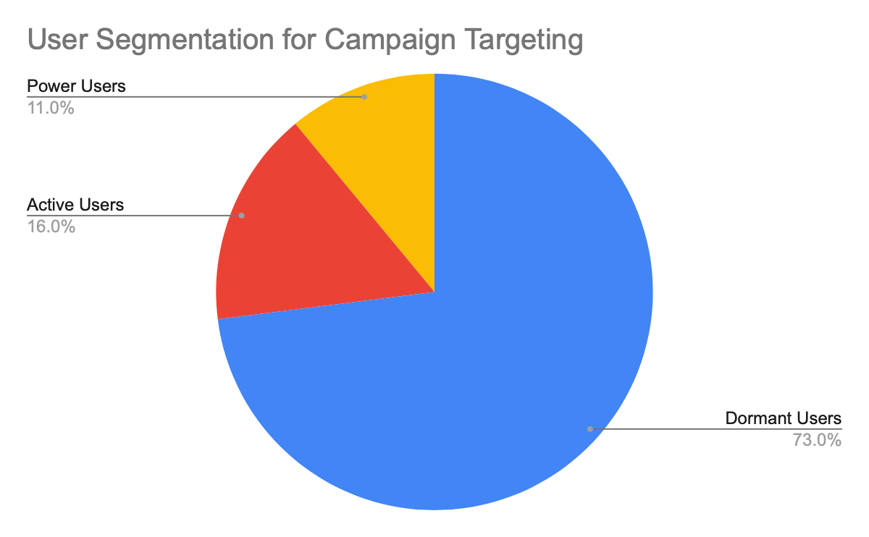
STRATEGY: SEGMENTATION & CAMPAIGN TARGETING
Dormancy is the largest pool: A massive 73.0% of the user base is classified as "Dormant Users," representing the primary audience for broad re-activation and acquisition ad campaigns.
Power Assets are rare: The "Power Users" segment is small at only 11.0%; their high-efficiency content must be leveraged exclusively for conversion-focused ad creatives.
Focus on the Active Funnel: The Active Users (16.0%) are the ideal group for A/B testing new features and high-ROI creatives before a broader Dormant user deployment.
RECOMMENDATION: ALLOCATE BUDGET: Increase ad spend on creatives sourced from high-volume, top-engagement creators to leverage their proven efficiency.

Slide 14
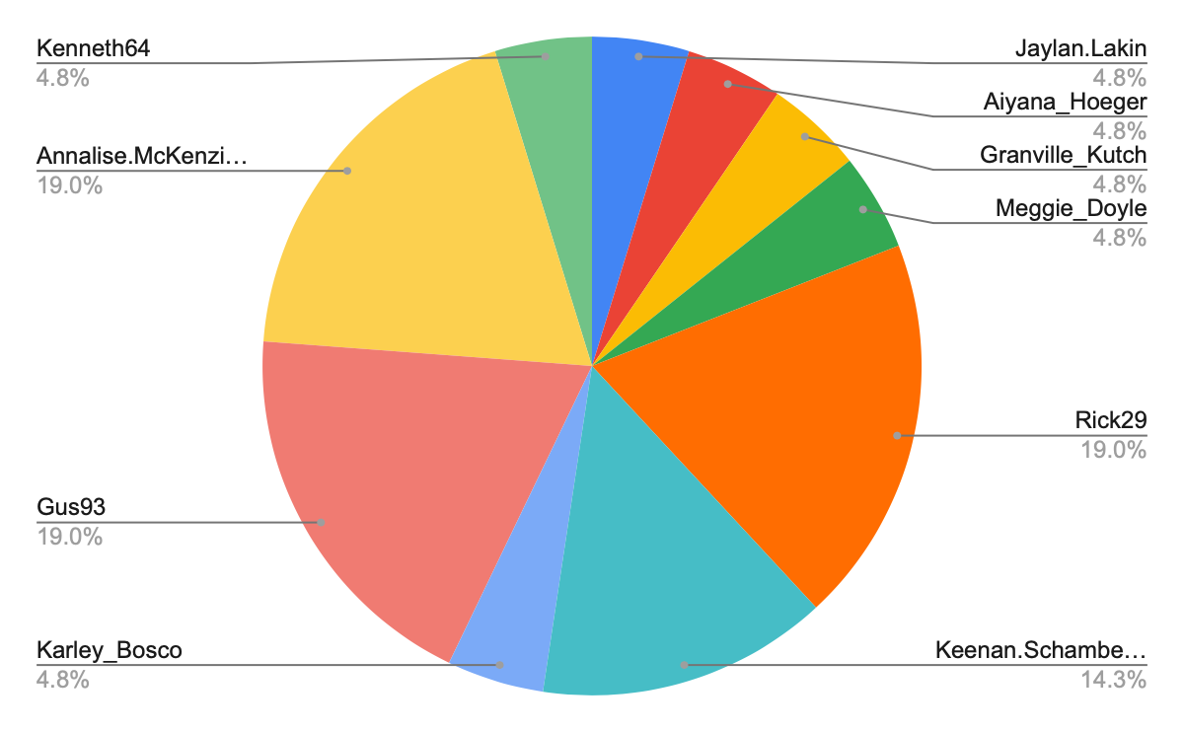
STRATEGY: AD MEASUREMENT & OPTIMIZATION
Volume is concentrated: Just three users (Rick29, Gus93, and Annalise.McKenzi...) account for 57% of the total posts displayed in this segment, confirming that content contribution is highly concentrated.
High Efficiency = High Conversion: Content sourced from these high-volume users is more likely to be high-quality and high-converting, making them ideal ad assets for testing and scale.
KPI INTEGRATION: The ultimate goal is to link campaign performance (CTR, CPA, ROAS) back to the creator-sourced creative to measure ROI per theme and creator.
RECOMMENDATION: ALLOCATE BUDGET: Increase ad spend on creatives sourced from high-volume, top-engagement creators to leverage their proven efficiency.

Slide 15
PROJECT RECOMMENDATIONS (FINAL MANDATE)
INSTITUTE THE PRECISE CONTENT LOCKDOWN: Enforce strict scheduling to the 5 PM - 6 PM Golden Hour (Post Hours 17-18) to capture the highest peaks in both Likes and Comments.
ACTIVATE THE DORMANT MAJORITY: Launch a personalized, tiered re-engagement campaign targeting the 73.0% Dormant User segment to convert them into Engaged Consumers.
FORMALIZE THE CREATOR TIER: Establish a formal reward program for Top-Tier Creators (Eveline95, Cesar93) providing exclusive feature access and recognition, ensuring long-term content velocity and loyalty.
AUDIT SYSTEMIC DATA ANOMALIES: Prioritize the investigation of the System-Created Follow-Backs (User ID 2) to ensure the integrity of the follower-count metric and to identify potential bot activity.

Slide 16
CONCLUSION
STRATEGY IS DEFINED: We have identified key users, mandatory timing (5 PM/6 PM), and high-ROI content themes (e.g., 'beach' and 'concert' conversation drivers) necessary to scale growth.
FOCUS ON EFFICIENCY: Future ad budget allocation must prioritize creatives sourced from High-Efficiency Creators (e.g., Donald.Fritsch, Aurelie71) whose content has superior engagement rates.
SEGMENT TO WIN: Success requires moving past generic outreach, focusing instead on tailored strategies for the massive Dormant (73.0%) segment and the critical Power User (11.0%) segment.
NEXT QUARTER GOAL: INCREASE PLATFORM-WIDE ENGAGEMENT RATE BY 15% by adhering to this data-driven strategy.

Slide 17
THANK YOU

